Slide 1
DISCRIMINATION

Slide 2
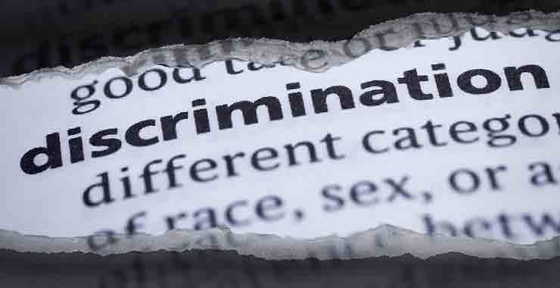

Slide 3
WHO IS DISCRIMINATED IN MY COUNTRY?

Slide 4
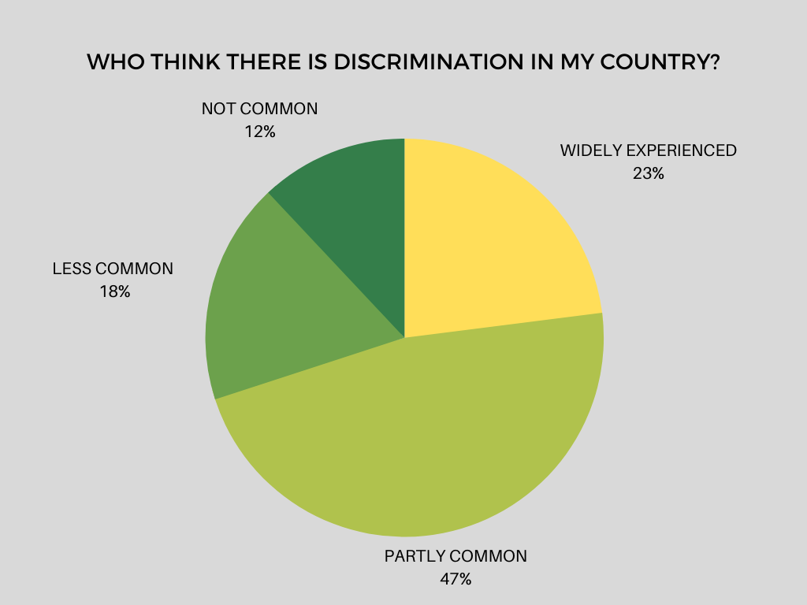
Turkey findings obtained at the end survey of 1064 people in 26 provinces representing the public and some results are as follows:

Slide 5
Perception of the prevalence of discrimination in people with high income is low and the perception was high in people with low income.
In addition, while the perception regarding the prevalence of discrimination in education areas at high school and university level is higher, it is believed that discrimination is not common in those with lower education level.

Slide 6
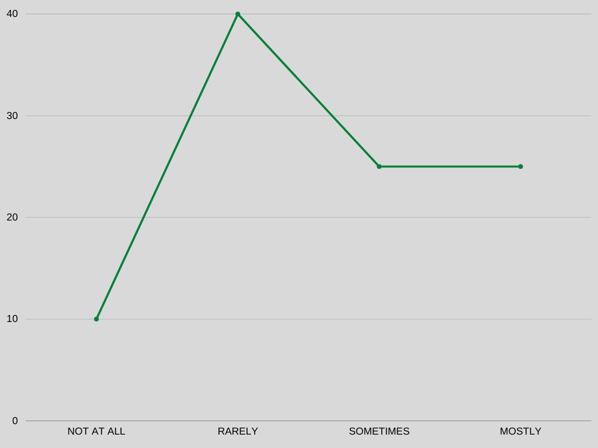
“Do you think we are experiencing discrimination based on ethnic origin?”
Notes:
25 percent mostly 25 sometimes 40 rarely 10 not at all

Slide 7
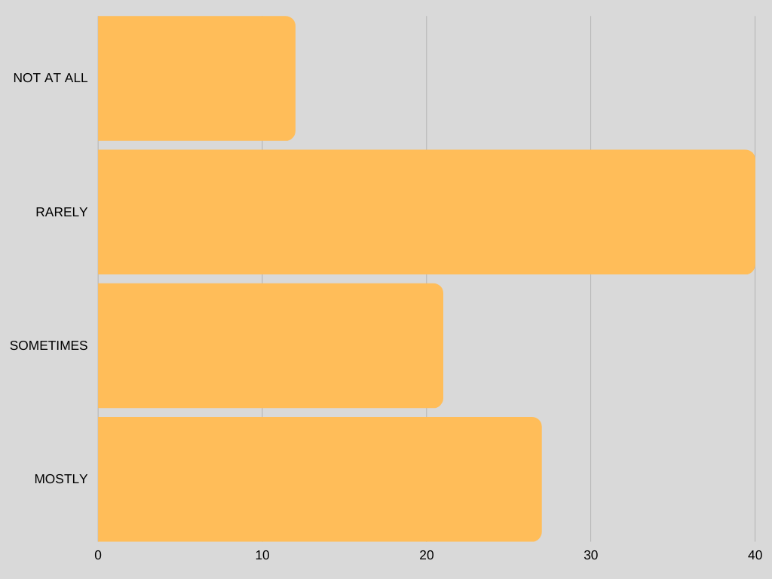
“Do you think there is religious discrimination in our country?”
Notes:
27 percent always 21 percent sometimes 40 percent rarely 12 percent not at all

Slide 8
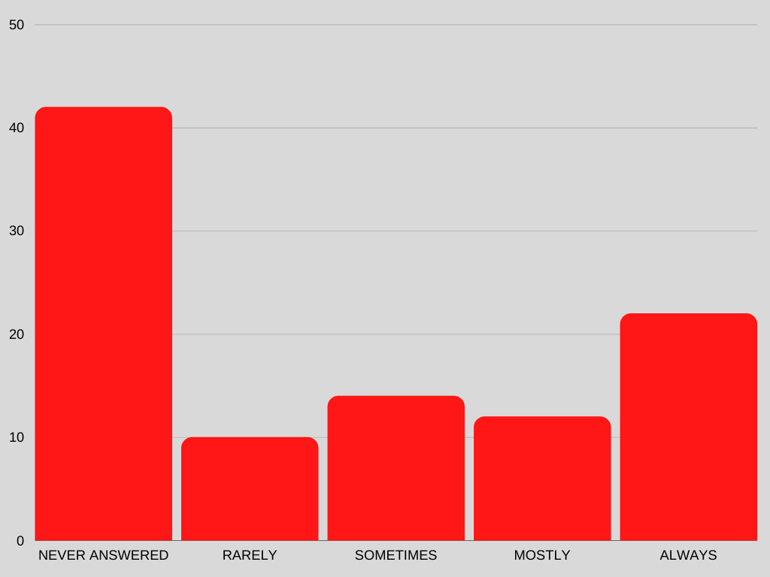
“Do you think we’re experiencing discrimination based on gender in Turkey?“
Notes:
42 percent never answered 10 percent rarely 14 percent sometimes 12 percemt mostly 22 percent always

Slide 9
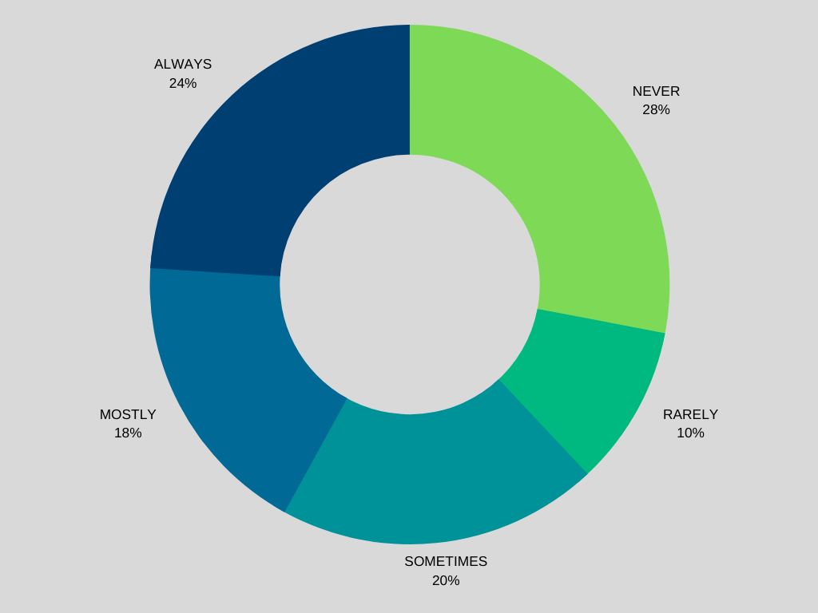
“Is there any discrimination about the political view?”

Slide 10
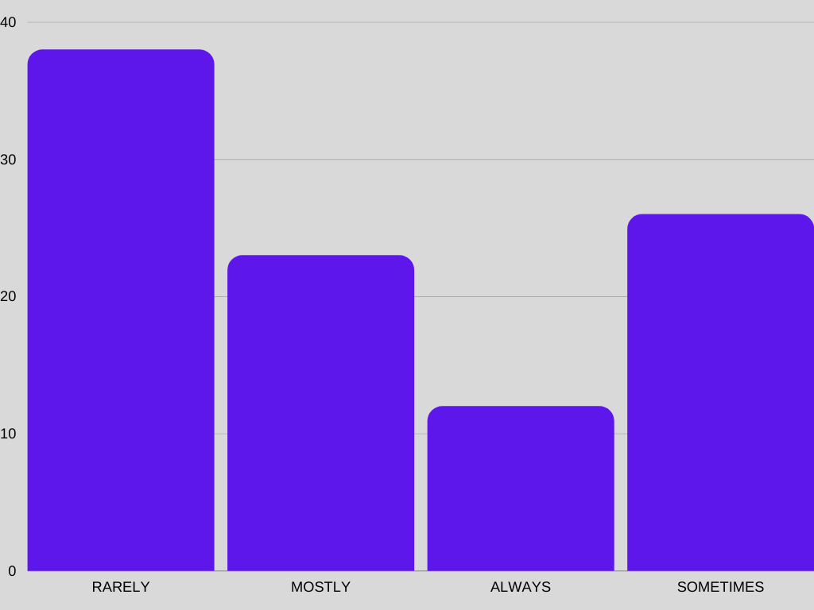
“Are we experiencing discrimination against refugees and immigrants?”
Notes:
38 percent rarely 23 percent mostly 13 percent always 26 percent sometimes

Slide 11
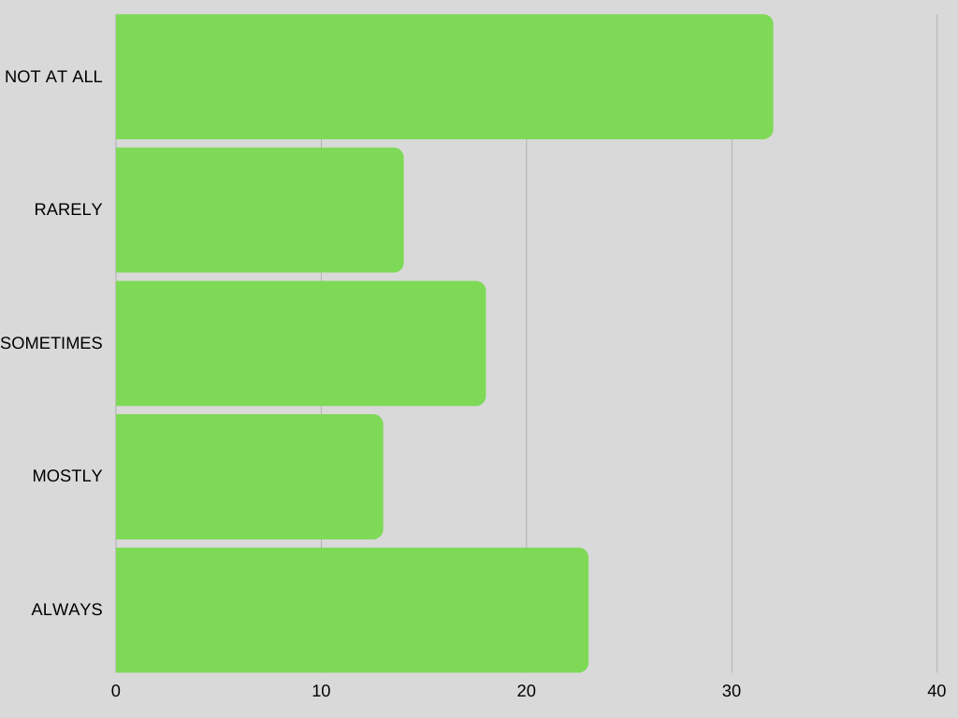
"Is there discrimination based on sexual orientation - gender identity?“
Notes:
32 percent never 14 percent rarely 18 percent sometimes 13 percent mostly 23 percent always

Slide 12
Who is discriminated against in Turkey?
It is essential for discrimination to be legitimized by different segments of society in general, to qualify discriminated groups, individuals and all kinds of discriminatory behavior as “fair” and to sustain discrimination. Because discrimination is only widely sanctioned or it can be sustained under unopposed conditions. In all conditions where discrimination occurs universally,
The creation of a discourse that the discriminated group poses a threat to the hypothetical majority is the most common way used by governments.

Slide 13
From this point of view, the discourse that the discriminated group poses a threat to the general public in different contents and forms in almost all of the discrimination areas that emerge in our country is constantly being built and reinforced. Theoretical approaches to discrimination pointed out that this threat perception can be created more effectively when sometimes based on realistic reasons. Threat perception can take various forms according to periodic conditions and the needs of the rulers, sometimes current and sometimes future fear scenarios are created, but similarly, all fear scenarios are placed on deviations from the general structuring of the uniform society.

Slide 14
For example;
Kurds wants to education in mother tongue and public service, constitutional citizenship and so on. the idea that if demands for identity are met, demands for a separate state will arise, and these demands will gradually lead to "partition of the country". Similarly, Circassians, Laz people (who live in Blacksea region) etc. the rejection of similar recognition requests by different ethnic groups creates the fear of partition of the country and is made incontestable.

Slide 15
In a general framework that starts from the damaging of the principle of secularism and extends to the future of sharia, the demands for the daily implementation of religious belief practices (headscarf, recognition of different sects, places of worship of different sects and removal of barriers to their institutional existence, etc.) fear scenarios that a radical transformation of the structure of society is aimed at today and in the long term. Bilgi University through documentation and reporting in the Dealing with Discrimination in Turkey report religion and belief in the field of discrimination victims struggle not through the law but they changing their lifestyle was stated. The 1982 constitution established the country as a secular state and provides for freedom of belief and worship and the private dissemination of religious ideas. However, other constitutional provisions for the integrity of the secular state restrict these rights. The constitution prohibits discrimination on religious grounds.

Slide 16
Headscarves women in Turkey
58 percent of women living in Turkey wear hijab.
This rate is higher in women older than 36.
9 percent of girls who go to high school in Turkey want to wear hijab.
5 percent of girls who go to high shool in Turkey has to wear hijab cause their family.
Discrimination of Headscarves People;
Women could not work with their headscarves in puclic institutions due to the public dress code which was enacted after the 1980 coup has been in effect for nearly 31 years.

Slide 17
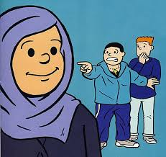

Slide 18
Creating the threat that the restrictions on the daily implementation of religious beliefs other than Islam, the demands of Christians, Armenians, Baha'i and other religious belief groups for recognition and freedom of worship and belief are not sincere, and that behind these demands there are plans to "capture" the country.

Slide 19
Creating threat perceptions against transvestites and transsexuals that they are unbalanced, prone to violence and carriers of disease, to justify their forced to live and work in certain parts of cities, and the discrimination and violence inflicted on them by both security forces and ordinary people, and the negativity of working conditions.

Slide 20
Defining sexual orientations different from heterosexuality as abnormal, unnatural and disease in order to legitimize the ideology that heterosexual sexual orientation is natural and normal, and to create the fear that sexual orientations such as homosexuality will lead to the "extinction of the human race" in order to normalize this mentality. Similarly, the generalization of the threat that sexual relationships based on sexual orientation different from heterosexuality pose a danger to sexual diseases. In this sense, it is necessary to focus on the concept of "risk groups". This concept, which is used by loading different contents for people, immigrants, displaced persons, refugees, children living or working on the streets, homosexuals, transvestites and transsexuals, who live in conditions that can be described as poverty in general, mentioned above, means that "risk" stems from the individual characteristics of the members of these groups. It serves to keep the negative and unfair living conditions out of sight and to legitimize discrimination by creating the impression.

Slide 21
WHO HAS BEEN TRYING TO HELP DISCRIMINATED PEOPLE?
IN TURKEY
Association for Monitoring Equal Rights
Zero Discrimination Association
Social Policy Gender Identity and Sexual Orientation Studies Association (SPoD)
etc.

