Slide 2
Discrimination in Poland

Slide 3
Regulations in Polish Law

Slide 4
DISCRIMINATION
It is a situation in which a person is treated less favourably than a person in a comparable situation due to his gender, race, ethnicity, nationality, religion, faith, views, disability, age or sexual orientation.

Slide 5
The Constitution of Poland in art. 32 provides that everyone is equal before the law and has the right to equal treatment by public authorities (paragraph 1). No one may be discriminated in political, social or economic life for any reason (paragraph 2).
It should also be taken into account that the constitution-maker paid special attention to the issue of gender equality in art. 33 of the Constitution which states that a woman and a man in Poland have equal rights in family, political, social and economic life.

Slide 6
To the basic legal acts aimed at ensuring compliance with the indicated constitutional norms and fulfilling the obligations related to the implementation into the national legal order of European Union directives belongs the Act of 3rd December 2010 on the implementation of certain European Union provisions in the field of equal treatment.
This Act defines the areas and ways of counteracting violations of the principle of equal treatment due to sex, race, ethnicity, nationality, religion, faith , views, disability, age or sexual orientation (Article 1). In accordance with art. 2 paragraf 2 of the Act on the implementation of certain European Union provisions in the field of equal treatment of the provisions of Chapter 1 (General provisions) and Chapter 2 (Principle of equal treatment and legal measures for its protection). This Act is not applied to employees in the cases regulated by the Act of 26th June 1974. - Labour Code.

Slide 7
The Labor Code declares unacceptable any discrimination in employment, direct or indirect, in particular due to sex, age, disability, race, religion, nationality, political beliefs, trade union membership, ethnicity, religion, sexual orientation, as well as employment for a definite or indefinite period, full-time or part-time (Article 113). Employees have equal rights in performign the same duties; this applies in particular to equal treatment of men and women in employment (Articles 112, 183c).

Slide 8
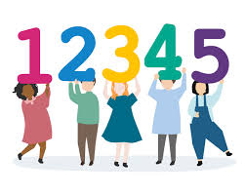
Discrimination in numbers

Slide 9
Who is discriminated against in Poland

Slide 10
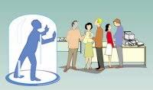
Who is discriminated against in Poland
46% Polish office and physical-intellectual employees admit that they have experienced mobbing in the workplace, more than half have been victims of verbal violence, and 14% of physical violence.

Slide 11
Statistically, women earn 80% of what a man earns in the same position, with the same qualifications or less than a woman.

Slide 12
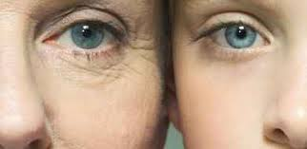
In Poland, discrimination based on age is the most frequently indicated form of discrimination in the workplace. Of all employees asked, 11 percent experienced it. People over 55 years old (23%) made the most complaints, followed by the young generation aged 16-24 (15%).

Slide 13
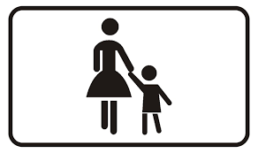
In approximately 95% of cases, courts grant childcare to mother, even if both parents are in the same financial and housing situation, and both parents have the same emotional relationship with the child.

Slide 14
Examples of discrimination

Slide 15
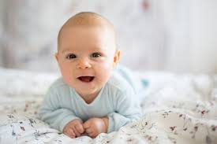
Due to gender
In Poland, changing tables for babies are usually found in women's toilets.
Most ads about children and especially babies are targeted at women

Slide 16
Due to gender or age
Common job advertisement:
"The company ... is looking for ... a woman under 35 for the position of the Board's assistant".

Slide 17
Due to sexual orientation
The krav maga instructor in Poznań refused to train LGBT people. The court fined him.
- The printer from Łódź did not accept the order to print posters promoting the LGBT subculture. After many hearings, the case was finally concluded by the Supreme Court, which found the accused printer guilty.

Slide 18
Due to disability
Asking a blind person with a guide dog to leave a restaurant
stairs to many institutions, offices, cinemas, museums, theatres and workplaces
ATMs too high
no adaptations in public transport, trains and planes

Slide 19
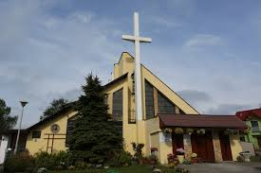
Due to religion
In Poland, only Catholic holidays
are non-working days.

Slide 20
Actions taken in Poland

Slide 21
The Ministry of National Education, the Ombudsman for Children, the Ombudsman for Civil Rights, the Government Plenipotentiary for Equal Treatment, Associations, NGOs are preparing information campaigns, workshops, conferences, suggestions for students’ activities, ready scenarios and materials for conducting classes on discrimination.

Slide 22
The government plenipotentiary for disabled people, Paweł Wdówik, deals with cases of discrimination and exclusion of disabled people. He is also a disabled person, blind and walks with a guide dog, i.e. a person who knows the needs and problems of this social group.

Slide 23
The Ministry of Family, Labor and Social Policy launched a program to help socially and professionally excluded people for 2020-2022 "From exclusion to activation", thanks to which social employment centres, i.e. centres and clubs of social integration, can improve the quality of their offer for these people.
They are above all long-term unemployed, people with disabilities, mentally ill, homeless, addicted - these are the groups most at risk of social exclusion.

Slide 24
In May 2019, Mayor of Warsaw Rafał Trzaskowski inaugurated the "Warsaw for Women" program package, which aims to protect women's rights. There were also established Women's Council and President's Plenipotentiary for Women. The assumptions also include increasing the in vitro program and building a "help chain" for victims of violence. Other cities in Poland intend to follow this example.

Slide 25
Only three cities: Nysa (in 2008), Aleksandrów Kujawski (in 2012) and Poznań (2019) have adopted the European Charter for Equality between Women and Men in Local Life. Several cities have taken preparatory actions.
In Poland The Charter is criticized by radical environments, mainly Catholic, which see in the implementation of equal opportunities the policies of "gender ideology", "destruction of the Polish family by LGBT" and an effective tool for political struggle in local governments.
The European Charter for Equality is a practical guide on how to step by step implement a plan for equalizing opportunities for men and women in the city.
The signing of The Charter is the formal commitment of local authorities in promoting the principle of equality between women and men, as well as a declaration of implementation of its obligations.
By December 2019, the Charter was signed by 1,784 municipal and provincial (regional) governments in Europe.

Slide 26
Actions taken by local authorities and institutions

Slide 27
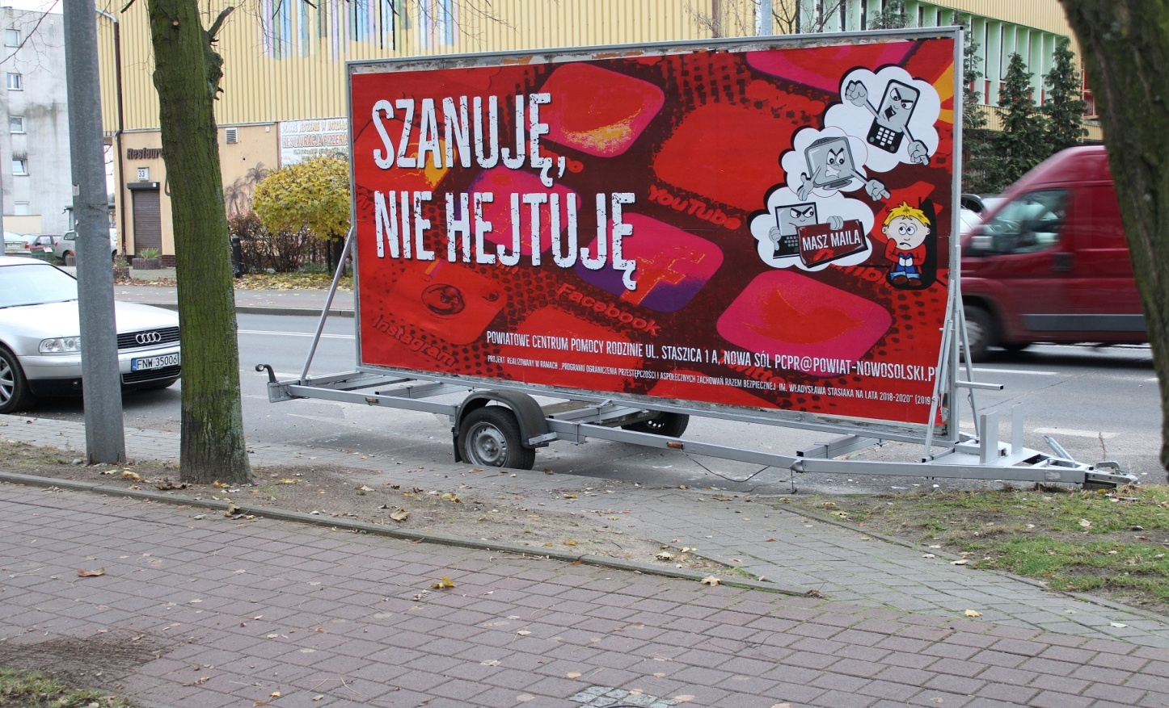
The Poviat Family Support Center in Nowa Sól is currently implementing the project "I respect - I don't hate." The project aims to increase accessibility and extend the offer of professional assistance to people at risk or experiencing online violence.

Slide 28
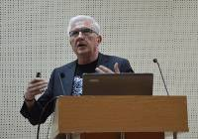
In 2018, the Nowa Sól library organized a meeting with the then president of Nowa Sól, Wadim Tyszkiewicz, on hate speech. During the meeting, the topic of discrimination against foreigners and national minorities was raised. A similar meeting was held at the University of Zielona Góra and in several schools in Nowa Sól.

Slide 29
Actions undertaken by the
K.K. Baczyński High School in Nowa Sól.

Slide 30
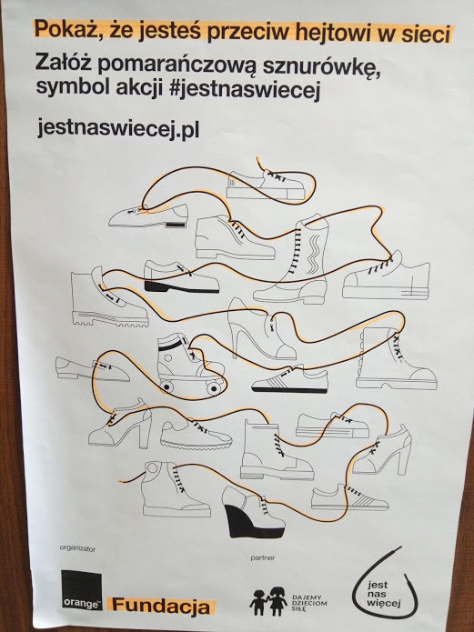
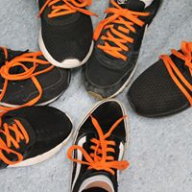
In the current school year, the school took part in an action organized by the Orange Foundation, which consisted in the fact that people who were against the hate in the network wore orange laces.

Slide 31
Lessons and programs to prevent discrimination and hatred among young people are implemented as part of the lesson with the class teacher and school counselor.
As part of cooperation with local judges, meetings are organized regarding discrimination and legal consequences of hatred and online aggression.

Slide 32
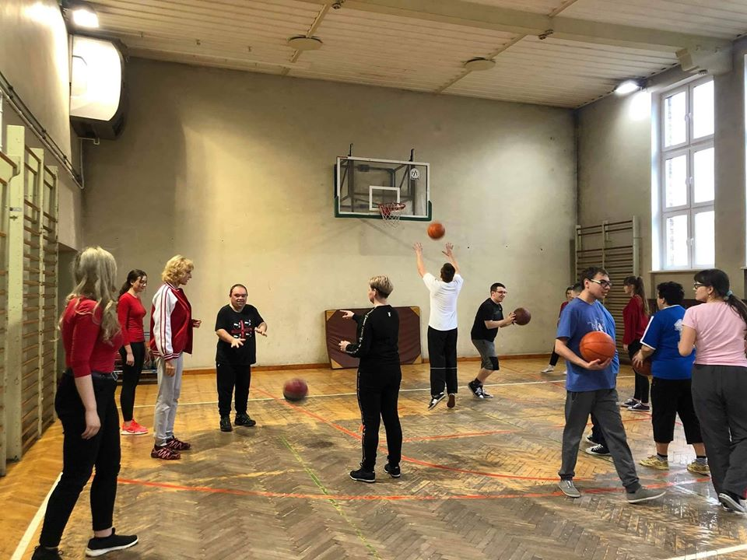
To prevent discrimination against people with intellectual disabilities, the school volunteers conduct sports activities for students with disabilities. Classes are conducted by students of our school under the supervision of a teacher.

Slide 33
As part of cooperation with a special school, we organize various actions that involve young people in helping and cooperating with people with disabilities. Every year, we are the co-organizers of the so called „ Olympics of Joy” for the students from a Nowa Sól special school which provides occupational therapy workshops.

Slide 34
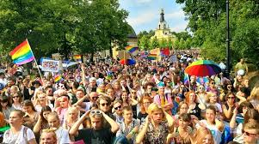
Manifesting discrimination in Poland

Slide 35
On March 21st, we celebrate the World Day against Racial Discrimination established by the United Nations in 1966.
On this occasion anti-racist demonstrations take place all over the world, in Poland the largest is held every year in Warsaw.

Slide 36
Parades and equality marches against legal and social discrimination, paying attention to the rights of minority groups, promoting social acceptance, celebration of minority pride, especially sexual minorities - lesbian, gay, bisexual, transgender and queer
Marches against intolerance and racial discrimination
Men's marches against discrimination of men in Poland
Marches against religious intolerance

Slide 37
Where to look for help in Poland?
Counselor or school psychologist
Pedagogue or psychologist in the Psychological and Pedagogical Counseling Center or Poviat Family Support Center
Ombudsman of Civil Rights
Local government organizations operating at offices in large cities, e.g. Gdańsk Centre of Equal Treatment, Multicultural Wroclaw

Slide 38
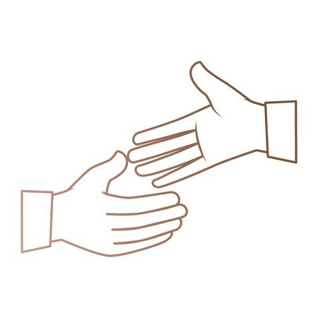
Depending on the type of the experienced discrimination
- National Labour Inspectorate
General Inspectorate for Personal Data Protection
Local NGOs supporting discriminated persons

Slide 39
The publication was created as a result of a project implemented with the financial support of the European Commission under the Erasmus + program. The publication reflects only the author's position. Neither the European Commission nor the National Agency are responsible for the content contained therein nor for the use of the information contained therein.

